Slide 1

Introduction to Waves
Notes:
How do mechanical waves affect technology, structures, society and the environment? Are the effects positive or negative?

Slide 2
Good Vibrations
A vibration is a periodic (repeated) motion of an object about an equilibrium point
Notes:
Do you know any terminology that we could use to describe different characteristics of this motion?

Slide 3
So What is a Wave?
A transfer of energy over a distance caused by an initial disturbance
Notes:
Notice that each particle actually just vibrates about an equilibrium point.
A single disturbance is called a pulse; a continuous disturbance creates a continuous wave

Slide 4
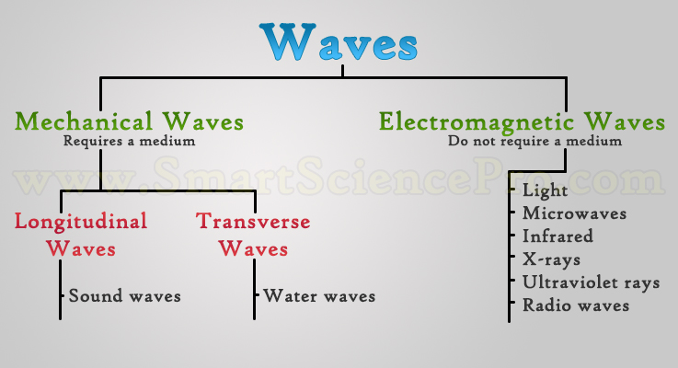
Mechanical Waves
A mechanical wave occurs when this energy is transferred through a material (ie. medium) due to an initial vibration
Notes:
The material is called a medium
In other words, the net motion of each particle is zero
(think of the wave at a sports game)
http://www.acs.psu.edu/drussell/Demos/waves-intro/waves-intro.html

Slide 5
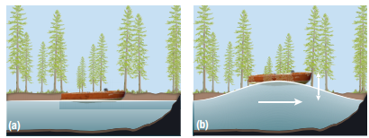
How do Mechanical Waves Travel?
Within the medium, nearby molecules are connected to each other by intermolecular forces
Each particle moves only slightly
There is little to no net motion
Notes:
The material is called a medium
In other words, the net motion of each particle is zero
(think of the wave at a sports game)
http://www.acs.psu.edu/drussell/Demos/waves-intro/waves-intro.html

Slide 6
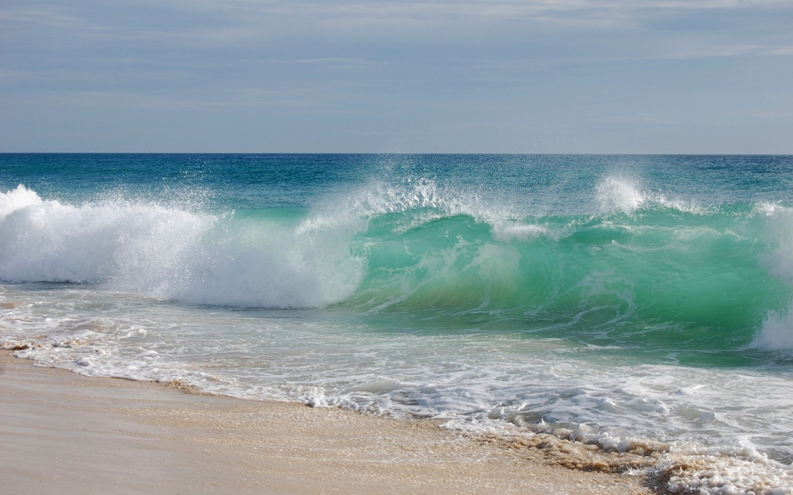
Stop to Think...
Minute after minute, hour after hour, day after day, ocean waves continue to splash onto the shore. Explain why the beach is not completely submerged and why the middle of the ocean has not yet been depleted of its water supply.
Notes:
Sound waves: drums, warnings/alerts
Wind to create water waves: surfing/entertainment

Slide 7
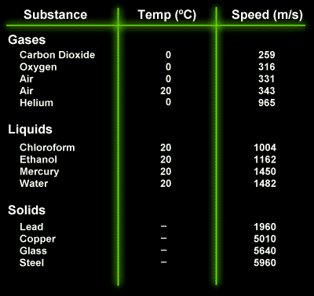
Are All Waves Created Equal?
Mechanical waves travel at different speeds depending on:
material
elastic materials are more efficient
density
liquids are more effective than gases
temperature
Notes:
Some materials are more effective than others at transferring energy; the effectiveness of a material is dependent upon the molecular structure, the density and the temperature
Elastic materials are those that return to their original shape after being disturbed
Fluids are effective transmitters of sound; however liquids are better than gases
In general, rigid materials transfer mechanical waves more efficiently than less rigid materials
Table of speeds from: http://library.thinkquest.org/19537/Physics4.html

Slide 8
Basic Waves A: Transverse Waves
Occur when the particles vibrate perpendicular to the direction of the flow of energy
Can you think of any examples?
Waves along a guitar string
Notes:
Caused by a transverse vibration
Ex. The vibration along a guitar string
Ex. Water waves
Aka s waves

Slide 9
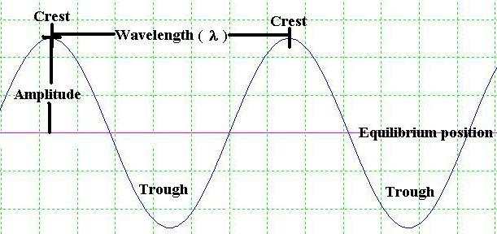
Characteristics
We may model this wave using a function:
y-coordinates: correspond to a particles displacement
x-coordinates: correspond to the phase
Notes:
Amplitude: maximum displacement of a wave from its equilibrium point
Crest: maximum point
Trough: minimum point
Wavelength: distance between two similar points in identical cycles in a wave
Phase: refers to the x-coordinate of a unique point – phase shift: is a shift of an entire wave

Slide 10
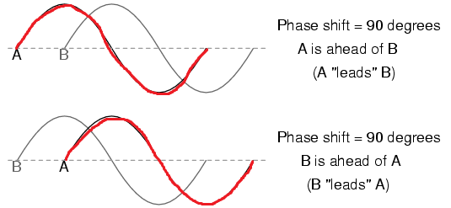
Phase Shifts
A phase shift is a shift of an entire wave with respect to an identical wave
It occurs when a wave has been moved left/right
Notes:
*Notice that we are making a comparison between two different waves or a shifted wave vs. the original wave

Slide 11
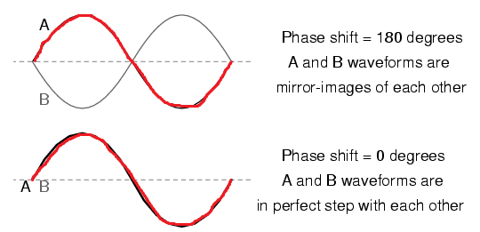
Extreme Phases
Perfectly Out of Phase:
In Phase:

Slide 12
Basic Waves B: Longitudinal Waves
Occur when the particles vibrate parallel to the direction of the flow of energy
Can you think of any examples?
Sound waves
Notes:
Caused by a longitudinal vibration
If longitudinal waves can be detected by the human ear, we refer to it as sound
(aka P waves)

Slide 13
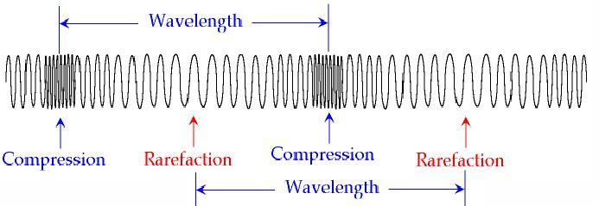
Characteristics
Notes:
Rarefactions are lower pressure regions while compressions have higher pressure
Amplitude: maximum pressure it creates compared to the pressure of the non-disturbed medium

Slide 14
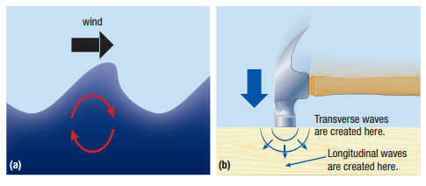
More Complex Waves
There are more complex types of waves as well

Slide 15
Timing Waves
Frequency (f): the number of cycles per unit time
Period (T): the time it takes for one cycle
Measured in Hertz
1 Hz = 1 s⁻¹
Measured in seconds

Slide 16
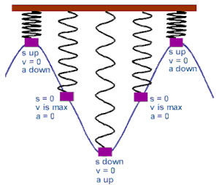
Example
A wave on a spring completes 10 cycles in 5.0 s. What is the frequency and period of the produced wave?
Notes:
Ans: f = 2.0 Hz and T = 0.50 s

Slide 17
